Slide 1
The Seattle Times Company
Online Network
Your best resource for reaching Western Washington

Slide 2
Why are so many advertisers interested in Online?

Slide 3
Your customers are online!
  Nearly half of marketers plan to decrease spending in traditional advertising channels like magazines and direct mail
  “Interactive advertising has clearly become a mainstream medium and one that can no longer be ignored as a critical piece of any marketing mix”
  --Greg Stuart, President and CEO, IAB (Internet Bureau of Advertising)
  “The media landscape has clearly changed with more and more marketers realizing that there is much to be gained from online advertising.“
  --David Silverman, Partner, PricewaterhouseCoopers
Source: 2004 Forrester Research; 2005 IAB Advertising Report, PWC

Slide 4



Online advertising drives shoppers to local stores
60% of adults with Internet access have used it to shop
Nearly 40% have purchased something within the last month
Nearly 33% of adults with Internet access have bought an item at a local store after checking the Web
More than 3/4 of 25-34 year olds with Internet access have shopped online in the past month
Source: Newspaper Association of America, “How America Shops & Spends, 2006”

Slide 5
Online product research impacts offline spending in a big way
  “ For many consumers online research is replacing the store as a way to gather information on products and pricing before purchasing at the store level”
  --Joe Pilotta, PhD, BIGresearch
  In the past year, online product research by consumers was
  responsible for driving $180.7 billion in offline spending
  78% of Internet users say that they shop online and then buy in retail stores
  Nearly 15% of total U.S. retail spending is influenced by the Internet
  Internet influenced offline sales grew 31% in 2003 and direct online sales grew 14%, while total U.S. retail spending grew 5% during a comparable time period
Source: 2004 American Interactive Consumer Survey, Dieringer Research Group; The Digital Future Report 2005, USC Annenberg Center for the Digital Future

Slide 6


Online is your customer’s first choice for accessing information and finding advertising
64%
  When consumers were asked to choose only one type of media to take with them to a deserted island, an overwhelming majority
  - 64% - chose a computer with Internet access
  Nearly half - 44% - of newspaper Web site users picked advertising as the reason they visit a newspaper site
44%
Source: 2005 Yahoo!/Harrisdirect Study; Power Users 2006 “An Engaged Audience for Advertising and News” Newspaper Association of America

Slide 7
Companies like Chrysler have figured it out…
  Chrysler Group is increasing their online ad spending by 20% this year and planning to make it the focus of marketing efforts
  Last year Chrysler, Jeep, Dodge spent $34.8M online out of a $1.58 billion advertising budget, reports TNS Media Intelligence
  "The objective is to make interactive the center of the marketing strategy so that consumers can be spoken to individually. Our strategy is that all media are going to become two-way.“
  --Julie Roehm, Director of Marketing Communications, Chrysler Group
Shouldn’t you?

Slide 8
Online advertising offers the benefits of traditional media…plus the added benefits of being online
  The reach and visual impact of television
  The frequency of radio
  The brand awareness of outdoor
  The targeting capabilities of direct marketing
  Plus
  Consumers who are online doing research on planned purchases
  Consumers who are a click away from your product or service
  Consumers who see your ad integrated with our content
  Consumers who can be targeted based on their behavior

Slide 9
As your customers adopt “new” technologies, your marketing opportunities online will increase
  Nearly half of marketers plan to decrease spending in traditional advertising channels like magazines and direct mail
  Because…
  “The increased adoption of broadband will continue to evolve the face of interactive advertising as more compelling media ads and video formats are created.”
  --Tom Hyland, Partner, PricewaterhouseCoopers
Source: 2004 Forrester Research

Slide 10
Online advertising is growing faster than any other media in the market
5-year Advertising Spending Trends in the Seattle-Tacoma DMA (In Millions)
Over 200% Growth
Base: Seattle-Tacoma DMA
Source: 2001-2005 Ad Audit Ad Spend Report

Slide 11
On average, online currently commands 12% of all media budgets, more than cable TV and radio
Industry Annual Media Distribution of Advertising Dollars
How to Read: The typical business directs approximately 12% of their advertising budget toward online, 15% to direct mail and 19% to newspapers.
Base: Seattle-Tacoma DMA
Source: 2005 Ad Audit Ad Spend Report

Slide 12
How fast is online growing?
  No medium since television has penetrated 50% of U.S. households as quickly as the Internet: 8 years
  In 2005, U.S. advertisers spent $12.5 billion on Internet advertising, more than in the entire outdoor advertising industry
  2005 spending represents 30% growth over the
  2004 total of $9.6 billion
  The numbers add up to:
  You Should Be Investing More in Online Campaigns!
Source: 2004 Doubleclick.com; 2004-5 IAB Internet Advertising Revenue Report, PWC

Slide 13
Why online in Seattle?

Slide 14
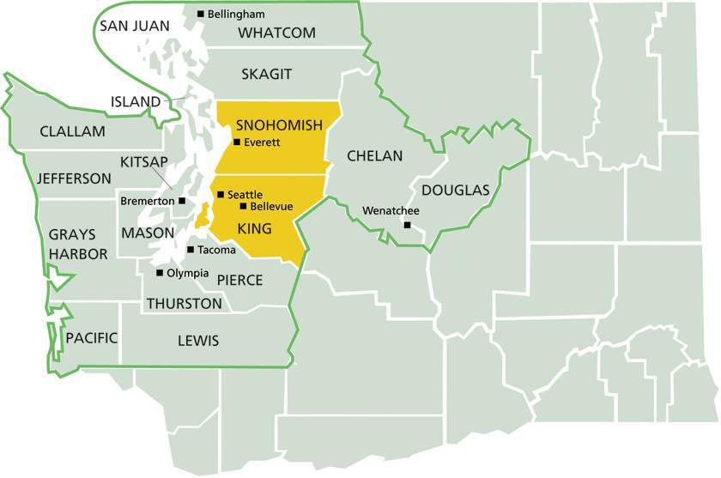
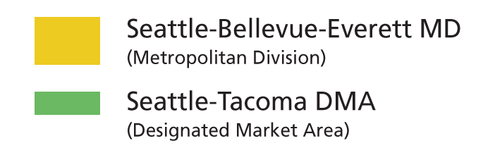
Stake your claim in a $100+ billion dollar marketplace
Legend
Notes:
Seattle-Bellevue-Everett MD includes King and Snohomish counties. Seattle-Tacoma DMA includes King, Snohomish, Chelan, Clallam, Douglas, Grays Harbor, Island, Jefferson, Kitsap, Lewis, Mason, Pacific, Pierce, San Juan, Skagit, Thurston and Whatcom counties.
2005 Population
2005 Buying Power
STC Audience
4.5 Million
$100.7 Billion
1.7 Million
1.3 Million
2.4 Million
$61.0 Billion
DMA (region)
DMA (region)
DMA (region)
MD (core)
MD (core)
MD (core)
Note: Spending power, as noted here, denotes Effective Buying Income (EBI) or after-tax discretionary income. Audience (past week) is composed of any six weekdays in The Seattle Times and the Seattle P-I, one issue of the Sunday Seattle Times and Seattle P-I and The Seattle Times Company Online Network (past 30 days).
Bases: Seattle-Bellevue-Everett MD; Seattle-Tacoma DMA (Western Washington region)
Source: Sales & Marketing Management 2005 Survey of Buying Power; 2006 Scarborough Research, Release 1

Slide 15
Nearly 8 out of 10 adults have internet access in Western Washington
Top 10 Designated Market Areas by Percent of Adults with Internet Access
Source: 2006 Multi-Market Scarborough Report, Release 1

Slide 16
Seattle is the top “unwired” city in the country
Top 10 cites with the greatest wireless Internet accessibility
Source: 2005 Intel “Most Unwired Cities” survey, Intel Corp. and Bert Sperling Research

Slide 17
Seattle ranks high in broadband use
55% of adults in the Seattle-Tacoma DMA have broadband Internet access compared to 46% on average in the U.S.
Top 10 Designated Market Areas by Percent of Adults with Cable, DSL or Wireless Internet Access
Note: Does not include ISDN Internet Access
Source: 2006 Multi-Market Scarborough Report, Release 1

Slide 18
Western Washington is a strong market for Internet based marketing due to our population’s affinity for Web based activities
Top National Rankings for the Seattle - Tacoma DMA Market
How to read: The index is a measurement of a group’s propensity to display a particular behavior. A score of 100 indicates average propensity. For example, Seattle adults are more than twice as likely than the national average to check traffic conditions via the Internet.
Note: All rankings are for usage in the past month except where otherwise noted.
Source: 2006 Scarborough Multi-Market Survey, Release 1

Slide 19
Broadband use is growing and
The STC Online Network’s visitors adopt it faster
Base: Seattle-Tacoma DMA (3,439,000 adults)
Source: 2002 -2006 Scarborough Report, Release 1

Slide 20
Nearly 240,000 Seattle-Tacoma Internet users plan to upgrade to broadband
Base: Seattle-Tacoma DMA (3,439,000 adults)
Source: 2002 -2006 Scarborough Report, Release 1

Slide 21
Seattle-Tacoma adults use the Internet for shopping and news
Base: Seattle-Tacoma DMA Internet Users (1,290,500 adults)
Source: 2006 Scarborough Report, Release 1

Slide 22
Growing numbers of consumers are shopping and buying online
Conversion Rate
How to read: Among Internet users shopping online for airline tickets (1,197,100 total shoppers), 85% (or 1,017,000) made a purchase online, while 15% (or 180,100) did not.
Base: Seattle-Tacoma DMA Internet users (2,620,900 adults)
Source: 2006 Scarborough Report, Release 1

Slide 23
Why the STC Online Network?

Slide 24
Put the leading local news and information
Web sites to work for you!
Leading Local News Destination
  More than half (51%) of all Internet users have read an online newspaper
  Nearly half (44%) of newspaper site visitors go online for the advertising
  Desirable Consumers
  Newspaper Web site users are younger, better educated, more affluent, spending more than twice as much time online and more likely to go online at home and at work than other Internet users
  Newspaper Web sites’ audiences are also nearly twice as likely to have shopped and/or made a purchase online compared to other Internet users
  Serving Advertisers
  Internet advertising is as likely as television to influence purchases.
  More than 4 out of 5 (82%) of newspaper site visitors purchased merchandise, goods or services online in the past six months compared to 52% of other Internet users
Power Users 2006: “An Engaged Audience for Advertising and News,” and Power Users 2004: “Newspapers’ Online Audience in a Broadband World;“ NAA and MORI Research and Harris Poll, June 2006

Slide 25
More visitors, visiting more often, means more impressions available for advertisers
N/A
N/A: not available
Power Users 2006: “An Engaged Audience for Advertising and News,” NAA, MORI Research and Harris Poll, June 2006

Slide 26
The Seattle Times Company Online Network ranks 7th Among All Web Sites in the Seattle-Tacoma DMA
Web Sites Visited by Seattle-Tacoma Internet Users in the Past Month
Base: Seattle-Tacoma DMA Internet users
Source: Nielsen @plan, Summer 2006
Notes:
The STC Online network reaches nearly 600,000 local Internet Users, outpacing the next closest local media contender and 4 times the reach of the closest local online newspaper. The STC network already is established as the place to turn for up-to-date news and information and now…shopping.

Slide 27
The Seattle Times Company Online Network ranks 14th among U.S. newspaper networks/Web sites
Top 25 U.S. Newspaper Networks/Web site rankings – June 2006
Note: The Seattle Times company Online Network includes seattletimes.com, seattlepi.com, NWsource.com, NWautos.com, NWjobs.com, NWhomes.com and NWapartments.com Base: Seattle-Tacoma DMA Internet users
Source: Nielsen//Netratings, Netview August 2006

Slide 28
The Seattle Times Company Online Network ranks 27th among current events and global news sites nationally
National Unique Audience Rankings of Current Events and Global News Sites
Base: U.S. Internet Users
Source: Nielsen//NetRatings, August 2006

Slide 29
More than $100 billion in consumer buying power has attracted more than 35,400 retail stores to the Seattle area
Retail Store Sales & Consumer Buying Power
U.S. Rank #12
U.S. Rank #13
$100,710,160,000
$69,760,777,000
Base: Seattle Tacoma DMA
Source: 2005 Demographics USA

Slide 30
Deliver your message to nearly 640,000 adults with approximately $24 billion in consumer buying power
Local Media Web Sites Visited by Internet Users in the Past Month
Note: The Seattle Times Company Online Network includes adults visiting seattletimes.com, seattlepi.com, NWsource.com, NWjobs.com, NWautos.com, NWapartments.com and NWhomes.com in the past 30 days. Base: Seattle-Tacoma DMA Internet users (2,659,400 adults)
Source: 2006 Scarborough Report, Release 1

Slide 31
The Seattle Times Company Online Network is strong competition for other national and local Web sites
Top 15 National and Other Web Sites Visited by Western Washington
Internet Users in the Past Month
Note: The Seattle Times Company Online Network includes adults visiting seattletimes.com, seattlepi.com, NWsource.com, NWjobs.com, NWautos.com, NWapartments.com and NWhomes.com in the past 30 days. Base: Seattle-Tacoma DMA Internet users (2,620,900 adults)
Source: 2006 Scarborough Report, Release 1

Slide 32
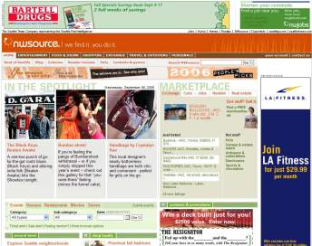
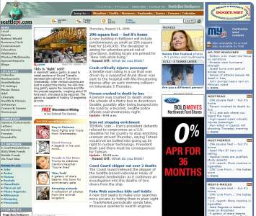
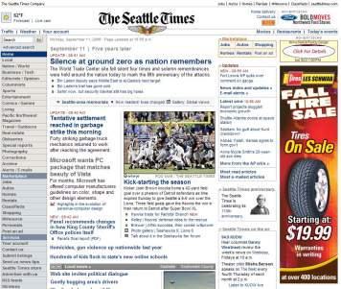
The Seattle Times Company Online Network is an integral part of a solid media buy
The Seattle Times Company
Online Network (Past Month)
Reach 638,000 Adults
7 spots on the “top-rated”
network TV station during prime-time
=
OR
86 prime-time spots across all cable
channels available for local media buys
(2 spots per station)
OR
85 spots during morning drive time
on the area’s top six radio stations
(17 spots per station)
Network TV reach is based on average ½ hour prime time viewership (KING, KIRO and KOMO) M-Sa, 8-11p + Su 7-11p. Cable reach represents average audience ½ hour prime time viewership among all cable channels available for local media buys combined. Radio reach is for average ¼ hour weekday listenership on KIRO-AM, KUOW-FM, KMPS-FM, KZOK-FM, KISW-FM & KRWM-FM during morning drive (M-F, 6-10a.)
Base: Seattle-Tacoma DMA (3,439,000 adults)
Source: 2006 Scarborough Report, Release 1

Slide 33
Visitors to The STC Online Network spend more time on the Internet
Base: Seattle-Tacoma DMA adults with Internet access (2,620,900 adults)
Source: 2006 Scarborough Report, Release 1

Slide 34
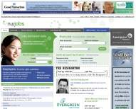
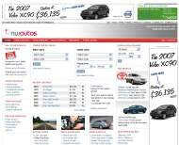
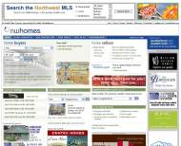
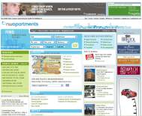
The Seattle Times Company Online Network ranks #14 nationally among newspaper networks/Web sites
seattletimes.com
seattlepi.com
NWsource.com
NWjobs.com
NWautos.com
NWhomes.com
NWapartments.com
Note: The Seattle Times company Online Network includes seattletimes.com, seattlepi.com, NWsource.com, NWautos.com, NWjobs.com, NWhomes.com and NWapartments.com Base: Seattle-Tacoma DMA Internet users
Source: Nielsen//Netratings, Netview August 2006
Notes:
Put this upfront?

Slide 35
Use the STC Online Network to reach a broad audience or target specific groups
Note: The above data were compiled from separate surveys of visitors to each site and cannot be combined or averaged.
* Not employed includes those who are seeking employment, retired, students, homemakers and those not seeking employment.
Base: seattletimes.com, NWclassifieds.com, NWsource.com and seattlepi.com audiences
Source: 2004 New Media Survey, Audience Profile Survey

Slide 36
The STC Online Network enhances your targeting of younger and white collar adults
40% of STC Online visitors are younger than 34 years old vs. 13% for the newspapers
63% of STC Online visitors are in white collar positions vs. 44% for the newspapers
*Not employed includes those who are retired, students, homemakers and those not seeking employment
Note: The Seattle Times Company Online Network includes adults visiting seattletimes.com, seattlepi.com, NWsource.com, NWjobs.com, NWautos.com, NWapartments.com and NWhomes.com in the past 30 days.
Base: Seattle-Tacoma DMA (3,439,000 adults)
Source: 2006 Scarborough Report, Release 1
Notes:
Demographically, advertisers will be reaching a complementary newspaper audience online. Our online audience tends to be made up of more men and 18-34 year olds. Their education and income are high and fewer are unemployed which means more discretionary income for shopping. This is a great audience for advertisers.

Slide 37
Position your business with award-winning brands from The Seattle Times Company Online Network
seattletimes.com
  2006 Online News Association – Annenberg School for Service Journalism finalist
  2006 Sigma Delta Chi/ Society for Professional Journalist first place award for Online Investigative Reporting
  2006 Editor & Publisher “EPpy Award” top 3 finalist for high school sports coverage
  2006 “Best of the West” for Online Investigative Reports first and third place finishes
  2004 National Press Club first place award for Distinguished Online Contribution
  2004 Society of Professional Journalists national award for Public Service Journalism
NWclassifieds.com
  2002 NAA Digital Edge Award Finalist – Best Classified Site –
  NWclassifieds.com/jobs
NWsource.com
  2002 NAA Digital Edge Award Finalist - Vertical Site - NWsource Outdoors
seattlepi.com
  2004 SPJ Regional Excellence in Journalism competition, First Place in Web Design

Slide 38
Unique visitor volume to the STC Online Network has grown by more than 860% in the past six years
More than 860% growth in only 6 years!
Note: 2006 data is comprised of the average number of unique visitors for the STC Network from January to July of 2006
Source: Seattle Times Company Site Log Data, Sage Metrics 2001-2006

Slide 39
Page view traffic to the STC Online Network has grown more than 400% in the past six years
More than 400% growth in 6 years!
Note: 2006 data is comprised of the average number of page views for the STC Network from January to July of 2006
Source: Seattle Times Company Site Log Data, Sage Metrics 2001-2006

Slide 40
Newspaper, Online and Target Marketing: A powerful combination

Slide 41
Use print and online together to access a broad audience or target specific groups
* Not employed includes those who are retired, students, homemakers and those not seeking employment
Base: Seattle-Tacoma DMA (3,439,000 adults)
Source: 2006 Scarborough Report, Release 1

Slide 42
The Seattle Times Company’s media network reaches one of the largest audiences in Western Washington
Reach of Seattle-Tacoma DMA Adults
Newspaper
without online
Newspapers with
NWsource.com
47%
Newspapers with
STC Online Network
45%
41%
38%
39%
37%
36%
31%
29%
30%
25%
24%
Note: STC Online Network includes seattletimes.com, NWclassifieds.com, NWsource.com and seattlepi.com.
Base: Seattle-Tacoma DMA (3,439,000 adults)
Source: 2006 Scarborough Report, Release 1

Slide 43
Extend your reach and frequency by advertising both online and in the newspaper
Exclusive and Duplicated Reach Between
The Seattle Times and the Seattle P-I Cumulative Reach (5 Weekdays, 4 Saturdays and 4 Sundays)
and 30 days on The STC Online Network
Note: Duplication shown between the combined cumulative reach of The Seattle Times and the Seattle P-I (weekday), The Seattle Times and the Seattle P-I (Saturday) and Sunday readers and The Seattle Times Company Online Network (past 30 days). Note: A weekday cume is any five weekday insertions. A Sunday cume is any four Sunday insertions.
Base: Seattle-Tacoma DMA (3,434,000 adults)
Source: 2006 Scarborough Report, Release 1
Notes:
New slide

Slide 44
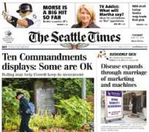
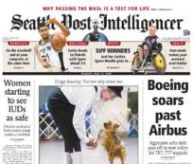
The Seattle Times Company has the strongest media mix in the market to effectively engage your client’s audience by reaching nearly 1.7 million Western Washington adults
The Seattle Times and the Seattle P-I
(5 weekdays, 1 Saturday and 1 Sunday)
+ 30 Days on the STC Online Network
1.7 million Western Washington Adults
=
The Seattle Times Company Media reach number and penetration are composed of Monday through Saturday issues of The Seattle Times and the Seattle P-I, one Sunday newspaper and 30 days on the STC Online Network.
Source: 2006 Scarborough Report, Release 1

Slide 45
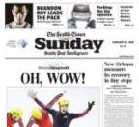
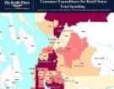











The Seattle Times Company’s portfolio of products will help you engage the audience’s attention and imagination
Newspapers
Market Research
STC Online Network
Promotions
Preprints
Doorstep Impact
Shared
Mail
Direct Mail
Notes:
(Victoria and Kay) Victoria to start….We’re more than a newspaper. We offer a rich and effective portfolio of solutions that can help you help your clients succeed.
Our newspapers remain the premier media brands in the market, with unsurpassed market reach, advertising that is welcomed as part of our content, and results for our advertiser. This year The Seattle Times is celebrating 110 years of local ownership by the Blethen family. This legacy demonstrates our commitment to the community and credibility as a primary source of news and information. Within the mass reach of the newspaper, there is the opportunity to target by different sections which offer varied demographics. (show listing of sections) We’re no longer inside a box. We offer your clients more creative ways to use the newspaper, such as creative shapes. (Show examples.)
(Click to addendum page) The STC Online network which includes seattletimes.com, seattlepi.com, nwsource.com and nwclassifieds.com ranks #1 among all local media sites and ranks impressively among the top national media companies such as Google, etc. Our print and online audience is growing and is one of the most desirable in the market. The STC Online network delivers over 76 million page views and 3 million unique visitors per month. The Seattle Times Company has the strongest media mix in the market to effectively engage your client’s audience and help them build market share by reaching nearly 1.7 million W. WA adults every week with 5 weekday newspaper insertions, 1 Sunday newspaper insertion and 30 days on the STC Online network.
Studies show that preprints are a relied upon source of advertising information, and a reason why many consumers buy the newspaper. (Show sample of Sunday insert package). JcPenny, Target, IKEA and Sears are among a few of our regular advertisers who consistently use inserts and get results.
The shared mail, Savings Source, TMC program (show sample package) provides a cost effective, reliable delivery of preprints and single sheets, as well as ads on the wrap – via our carriers in the newspaper and via US mail to non-subscribers. Pharmacies as well as home improvement retailers are regular advertisers with Savings Source. Our Savings Source package can also be zoned in the Metro, East, South or North zoned. In addition, our Zip Xpress, print and deliver program, may be zoned by zipcode.
(click to addendum page) Our target marketing services offer a customized solution for your business. We offer more than a commodity. We provide a turnkey service including data analysis, list services, creative services, printing, mailing and distribution. We are the only mailing service that bills postage. (Go to Maax page)
Our doorstep impact programs include polybags, newspaper tags, and toppers, but most recently we just launched our “power notes” program which allows one advertiser to be on the front page of the paper. (Show examples)
We also offer promotions, sponsorships and events which are a great complement to an advertising program. We have created more than 80 individual promotions in the past year for clients such as the Pacific NW Ballet, BEWI productions Inc for their 2004 SnowSports Expo, and Millennium Ford to help build traffic and brands. In addition, with the launch of our own Digs and @ Home Sections in 2005, we launched a Whole House Makeover contest. We also offer circulation promotions and sponsorships at all major events which provides a win-win for our clients as well as The Seattle Times and the Seattle P-I to increase circulation. These programs offering advertiser sponsored newspapers at local events such as Bumpershoot or major sporting venues such as Seahawks games in addition to new mover programs.
Everything is backed up by research. We use both syndicated and proprietary research to help our customer understand media and market trends, consumer interests, shopping habits, and more. Our resources include: Scarborough, Nielsen/Net Ratings, and Claritas.
All of these combined resources can help you and your customers with market intelligence, customer knowledge, and the media to deliver and engage their audiences.

Slide 46
The Homepage Sponsorship of seattletimes.com and seattlepi.com helps you reach more than 435,000 adults
Sample Media Campaign
Audience Penetration of DMA
(% of adults reached)
(# Days on seattletimes.com & seattlepi.com)
Adult Audience
Reached in DMA
Average Frequency
15.5
435,800
Estimated Gross Impressions
6,762,200
Gross Rating Points
198
Base: Seattle-Tacoma DMA Adults (3,413,200 adults)
Source: Scarborough Reach and Frequency Report 2005, Release 2
Notes:
By sponsoring the Homepage of seattletimes.com and seattepi.com for 30 days, an advertiser can reach 12.8% of the Seattle-Tacoma DMA or 435,800 adults age 18+.
Average frequency is the number of times a person is exposed to an advertising message. With a 30-day homepage sponsorship the average adult will be exposed to an advertisers message 15.5 times for a total of 6,762,200 exposures delivered or ad impressions. The campaign would generate 198 GRP’s.
GRP (short for Gross Rating Point) represents the percentage of the target audience reached by an advertisement. If the advertisement is shown more than once, the GRP figure represents the sum of each individual GRP. Therefore, a advertisement showing 5 times reaching 50% of the target audience would have 250 GRP = 5 x 50%.

Slide 47
The Seattle Times Company Media Network delivers the market
*Page views are recorded for each page requested and fully loaded by the user.
**Unique Visitors: A unique visitor is identified by a cookie which creates a unique ID when a person loads a page from one of our sites. Unique visitors are only counted once within a reported period of 30 days for each site or the network.
A weekday cume is any five weekday insertions. A Sunday cume is any four Sunday insertions.
Source: ABC Audit, 3/31/05; 2006 Scarborough Report, Release 1; Sage Metrics Online Traffic Report, August 2006

Slide 48
Scarborough Survey Methodology
  Survey Timing:
  March 2005 – February 2006
  Survey Method:
  Phone and Mailed Questionnaires
  Respondents:
  Adults 18+
  Sample Size:
  5,001 in DMA*
  3,500 in MD**
  Tolerance Factors:
  Plus or minus 1.51 percentage points (DMA level)
  Plus or minus 1.23 percentage points (MD level)
Scarborough Research is the premier source for consumer insights. They measure the shopping patterns, lifestyles and media habits of consumers locally, regionally and nationally. From retail outlets to home improvement stores to cellular phone preferences to travel, Scarborough measurements detail the dynamic lives of American adults.
Scarborough Research’s core services include 74 local market studies and a national database. These tools cover 1,700 categories and brands including comprehensive retail shopping behaviors, lifestyle characteristics, in-depth consumer demographics and media usage patterns.
*Designated Market Area (17 counties in Western Washington)
**Metropolitan Division (2 counties: King and Snohomish)

Slide 49
Audience Profiler Survey Methodology
  Survey Timing:
  October 2004 to December 2004
  Survey Method:
  Online Pop-Up Intercepts
  Respondents: Adult Visitors to The Seattle Times Company Online Network age 18+
  Tolerance Factors:
  Plus or minus 2.0 to 4.1 percentage points

Slide 50
We look forward to being your partner!
Presented by Your Name Here
p: 206/652-0000
e: e-mail@seattletimes.com

