Slide 1

A Special Presentation for:

Slide 2
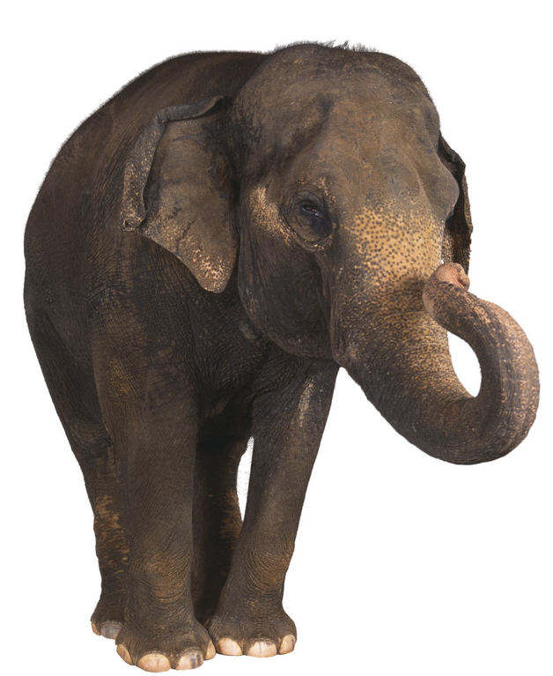
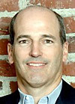
Let us address the elephant in the room:
"What is the merger of Microsoft and DRIVEpm going to do to the their products?”
“We've been at this about 12 months as a combined entity and we feel like we've accomplished a lot in that time."
Brian McAndrews
Senior Vice President,
Microsoft's Advertiser and Publisher Solutions Group
… but stay tuned, there’s more to come!
(c) Microsoft. All Rights Reserved.
| 2
Notes:
Talking Point(s):
We’ve come a long way in 12 months. Many of our backend processes are moving towards integration, but we still have work to do. As a trusted partner of DRIVEpm, eBay has the opportunity to help us shape what that future will look like. By working together, sharing information and finding innovative ways to meet eBay’s marketing goals, both eBay and Microsoft/DRIVEpm can achieve great success and shape the digital advertising future.
2

Slide 3


eBay and DRIVEpm share the same value:
Our clients come first
"What is good for buyers is ultimately good for sellers …This successful balancing of the ecosystem is what makes for a healthy ... marketplace."
John Donahoe, President and CEO of eBay, Internetnews.com, April 16, 2008
“DRIVEpm is ranked in the top five across four categories, and is ranked first for ‘keeps promises’ and overall value.”
Jack Myers, Survey of Advertising Executives, 2007
(c) Microsoft. All Rights Reserved.
| 3
Notes:
Talking Point:
Both eBay and DRIVEpm are laser focused on what is going to work for our clients.
eBay did this by removing the negative reviews of their buyers, making people more likely to shop on their site.
DRIVEpm does this by creating products that work harder and smarter for our client’s campaigns to ensure that our clients get the best value for their advertising dollar.
3

Slide 4
We put you at the center of our business
We train, structure, target and build the best teams possible – our focus and actions revolve around one thing:
Your campaign’s success
Sales Manager
Advertising
Operations
Manager
Client
Relationship
Manager
That is why there are six sets of eyes on every eBay campaign
| 4
| 4
Notes:
4
4
Talking Point(s):
Another area where DRIVE is different is in the area of expertise.
We train, structure, target and build the best teams possible----our actions, roles and focus revolve around advertiser success and goals. (You have earned the right to say this). From the moment you decide to try DRIVE and throughout your campaign we’ll help you maximize your results. And our efforts are backed by a team of industry experts who know the latest trends, concerns and success factors for specific types of advertisers and the unique requirements of publishers. And of course DRIVE is just one of many opportunities that Microsoft has to offer advertisers…

Slide 5
The DRIVE Difference for eBay:
Better results from a better idea
Better Results
Advanced
Technology
Premium Media
Greater Audience Insight
Better Targeting Control
Complete Control of your Brand
Atlas tracking, measurement and reporting technologies.
DRIVE only includes the top 250 publishers
(c) Microsoft. All Rights Reserved.
| 5
Notes:
DRIVE is founded on a core idea that ultimately produces better results for you. Here’s our simple, yet different approach. We combine the most advanced, widely used, Microsoft advertising technologies with the “A” list of top 250 media properties.
5

Slide 6
Our unique buying strategies means
better impressions for eBay
Publisher Direct
DRIVEpm
Other Networks
(Ad.com, ValueClick, SpecificMedia, etc.)
Exchanges/Marketplace
(RightMedia, AdBrite, etc.)
Single Sites
Buy based on Comscore’s Media Metrix Top 250
Control
Industry Overage
# of impressions
(c) Microsoft. All Rights Reserved.
| 6
Notes:
Talking Point(s)
Single Sites:
Negotiating with single websites in neither cost nor time efficient for eBay’s needs
Comscore’s Media Metrix Top 250:
eBay would get the web’s best impressions available, with one buy
Industry Overage:
Problems arise when eBay’s online ads appear on sites inappropriate to their brand

Slide 7
We can deliver a large audience for eBay’s campaigns …
We deliver an audience of over 48 million unique visitors.
This is enough to fill The San Francisco Giant’s AT&T Field more than a 1,000 times.*
And we do it every month
In fact, nearly half of DRIVEpm’s audience visited eBay in May, 2008.
*Note: San Francisco’s Giant’s AT&T stadium can seat 43,000, including standing room; Sources: sanfrancisco.giants.mlb.com; comScore cross visiting report, June 2008
(c) Microsoft. All Rights Reserved.
| 7
Notes:
Talking Point(s):
Analogy for eBay client: What would you do for a campaign if I could take your next ad campaign and put it in center field of AT&T park and guarantee a standing room only crowd would see it? Now, what if they were rabid fans? Now, what if I could do that a thousand times a month?
HIGH GAIN QUESTION: Okay, so what would you do for an ad if you knew that it was going to be seen by nearly 30 million crazy fans? (48 million unique visitors x 62% addicts=29.7 million addicts
Comscore Media Metrix Data:
According to Comscore’s “Cross Visiting Report” 49.6% of DRIVEpm’s audience visited eBay in May 2008. The flipside of this is that 78.4% of eBay’s audience visited DRIVEpm’s network.
DRIVEpm’s audience index’s at 121 for visiting eBay’s site. This means they are 20% more likely than the average online adult to go there!
DRIVE is founded on a core idea that ultimately produces better results for you. Here’s our simple, yet different approach. We combine the most advanced, widely used, Microsoft advertising technologies with the “A” list of top 250 media properties.
7

Slide 8
…or we can zero in on eBay’s target audiences
eBay can connect with a target audience through one or a combination of variables.
Demographic
and
Psychographic
Fine
Tune
Behavioral
Client Site Visits
House/Rental
Email List
Purchase Behavior
Product Portfolio
Loyalty Marketing
PRIZMne clusters
Geographic location
Inferred Gender
SIC code
Category
Day Part/Day
of Week
Broad/Narrow Band
ISP/Domain
At Home/At Work
(c) Microsoft. All Rights Reserved.
| 8
Notes:
8
Talking Points:
Through world class targeting variables, control is achieved through choosing targeting variables in line with the program strategy.
Behavioral – how and audience interacts with the advertiser (site, email, microsite, etc)
Demographic/Psychographic – identifying the audience through profiles, location, gender, consumption of category related information
Fine Tune: use these levers to isolate the and truly speak to the audience (ex: at work..)
Throughout this page, show examples of how you might combine variables to specifically suit the advertiser you are meeting with

Slide 9


Remessaging
eBay “Door Openers”
Find only consumers within the DRIVEpm network who
have visited the WL Hotmail, WL Messenger, MSNBC, FOX Sports
and any other Microsoft Channels Where eBay is running display advertising campaigns across
Use broad based branding creative to bring them back to shop at eBay
Use “If/Then” Logic
  If visited less than 3X in six months then show branding creatives
  If visited more than 3X in 6 months then show In-Mkt incentive based creative
eBay “Hand Raisers”
Remessage to consumers who have recently been to the
MSN Home Page
Target this audience with a specific message to push
them further down the funnel
Draw user back in and place them as far down the
funnel as possible

Slide 10
DRIVEpm can target specific segments of eBay’s buyers depending upon needs and goals
eBay
Awareness & Reach
Premium Network RON, sustained through peak seasonal promotions; CPA option
eBay
Shoppers
Custom Category created based on eBay’s target profile
eBay
Key Consumers
Home Page Re-messaging*
eBay
Window Shoppers
Passers-by but Not
Shoppers Re-messaging*
eBay
“Power Buyers”
Shoppers and Loyalty
Member Re-messaging*
*Re-messaging campaigns require action tags
| 10
Notes:
10

Slide 11
Essential components for taking eBay’s digital marketing to a new level
Robust
technology
Unique access to inventory
For delivering targeted, sequenced ads across all channels
So you can target your audience in appropriate places
Transformational Marketing Results
Greater audience insight
Greater control of your audience and your brand
A partner with unparalleled industry expertise and opportunities
World class analytics
A vast warehouse of data
To quickly assess results and optimize performance
To inform which users should receive which ads
High touch, consultative advice
To help you figure out what
changes are necessary
(c) Microsoft. All Rights Reserved.
| 11
Notes:
Let’s go back to our ingredients for success idea. Microsoft truly brings all these elements together in the DRIVE network. The unique combination of advanced technology and premium media. Advanced reporting based on better data, greater scale and better technology. And a consultative relationship recognized in our industry as being the best.
For you, that means better audience insights, greater control of the ways you reach your desired audience, complete control of your brand, and a partner with unparalleled industry expertise and opportunities.
11

Slide 12



Microsoft Advertiser & Publisher Solutions
San Francisco DRIVEpm Team
Anna Raus
Regional Sales Manager
415-420-9591
annar@microsoft.com
Erin McMahon
Sr. Account Executive
415-976-6445
Erin.McMahon@microsoft.com
Notes:
12

Slide 13

Jason Runge, June 12, 2008

Slide 14



Who Adidas is Today
INSIGHT
CONTROL
EXPERTISE
“North America is key to our success.”
– Herbert Hainer, Chairman and CEO of adidas, AG

Slide 15
Who Adidas is Today
INSIGHT
CONTROL
EXPERTISE
$13.7 billion in global revenue in 2007, second only to Nike with $16.3 billion
  North America accounted for less than 30% of the overall in 2007, down 2% from 2006.
With the 2006 acquisition of Reebok, Adidas increased it’s global market share from 16% to 22%
  The Reebok acquisition was a deliberate strategy to confront Nike’s North American market share of 36%
“In North America, we project a declining market in 2008.” – adidas Annual Report 2007
  So, how will Adidas reach the valuable but very fragmented and declining North American sports apparel audience in 2008?

Slide 16
Strategy for Success:
Make every marketing dollar count…
INSIGHT
CONTROL
EXPERTISE
Network Takeover, RON to generate brand awareness around specific events such as the 2008 Olympics in Bejing
Premium Reach
Custom Category built around demographics of the “early adopter” audience
Key Consumers
Door Openers
Re-messaging to Adidas.com visitors
Re-messaging to those who have actively engaged with Adidas brand online but have not explored specific product pages
Hand Raisers
Re-messaging to previous users who have experienced the Adidas brand story online as a continuation of the overall brand experience
Loyalists
Notes:
16
16
Talking points:
This should be customized based on what the advertiser is trying to fix, accomplish, or avoid (as demonstrated through the second point in “framework”)

Slide 17
Performance By Targeting Variable
Connect with your target through one variable or a combination of variables…
INSIGHT
CONTROL
EXPERTISE
Conversion
Rates Versus
Untargeted Media
Specialized Targeting
Day Part/Day
of Week
Broad/Narrow Band
ISP/Domain
At Home/At Work
Geographic & Demographic
PRIZMne clusters
Geographic location
Inferred Gender
SIC code
Category
Behavioral Targeting
Client Site Visits
House/Rental
Email List
Purchase Behavior
Product Portfolio
Loyalty Marketing
Multi-Variable Targeting
Specialized
Geo & Demo
Behavioral

Slide 18


Control Over Your Brand
Four ways DRIVE helps you control your brand
INSIGHT
CONTROL
EXPERTISE
Premium Publishers and Impressions
No Impressions on other networks
Opt Out Options
Message Relevance…
Notes:
Networks are notorious for dragging reputable brands through un-reputable channels, placing ads on sites that reflect poorly on the advertiser, and placing ads on other networks. And the advertiser never knows.
Because DRIVE only includes the top 250 publishers, you know that your ads will only be placed on the highest quality publisher sites.
DRIVE doesn’t buy impression on other networks, so “Daisy-chaining” will never occur, and will never be an issue that will surprise you later.
Even within our tight universe of the top 250, you can remove specific sites that are inappropriate for your campaign or brand
And, of course, DRIVE provides more targeting options that help you ensure that your message is reaching the appropriate audience. Relevance has a lot to do with the way your brand is perceived. Let’s talk about those options…

Slide 19
Ingredients For Success
Essential components for taking digital marketing to a new level
Robust
technology
Unique access to inventory
For delivering targeted, sequenced ads across all channels
So you can target your audience in appropriate places
Transformational Marketing Results
Greater audience insight
Greater control of your audience and your brand
A partner with unparalleled industry expertise and opportunities
World class analytics
A vast warehouse of data
To quickly assess results and optimize performance
To inform which users should receive which ads
High touch, consultative advice
To help you figure out what
changes are necessary
(c) Microsoft. All Rights Reserved.
| 19
Notes:
Let’s go back to our ingredients for success idea. Microsoft truly brings all these elements together in the DRIVE network. The unique combination of advanced technology and premium media. Advanced reporting based on better data, greater scale and better technology. And a consultative relationship recognized in our industry as being the best.
For you, that means better audience insights, greater control of the ways you reach your desired audience, complete control of your brand, and a partner with unparalleled industry expertise and opportunities.
19

Slide 20


Microsoft Advertiser & Publisher Solutions
DRIVEpm
Jason Runge
Director of Sales, Western Region
206-816-8179
jrung@microsoft.com
Notes:
20
20
Customize with your team information

