Slide 1
Credit Card Payments 101
Speaker name
Title

Slide 2
We Will Cover:
US credit card history
Fundamentals of credit cards
Types of credit cards
Mechanics
Where’s the money?
Security & trust
Innovation
Q&A

Slide 3
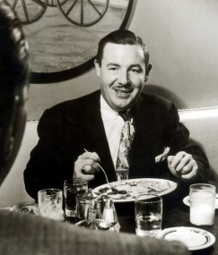
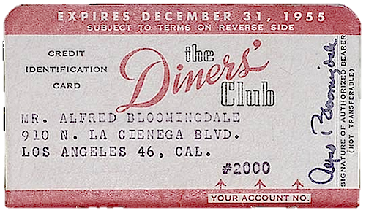
Once, Not-So Long Ago…
It all began when a man named Frank McNamara had dinner in a New York restaurant, but left his cash in another suit. He resolved never to be embarrassed again.
He founded Diners Club. The first credit cards accepted nationwide.
Life Magazine proclaimed him one of the “100 Most Influential Americans of the 20th Century”.
Not to shabby for a guy that forgot his wallet.

Slide 4
Timeline of Credit Card Growth
1950’s
Individual banks try card issuing but most fail – Except BofA in California
1960’s
Groups of banks form “co-operatives” so all member bank cards can be used at all member bank merchants
1970’s
MasterCard formed by combining bank associations
Visa formed by Bank of America franchising banks
1950
1960
1970
1980
1990
1958
American Express and Carte Blanche introduce general purpose card
1971
Visa follows Mastercard by transforming franchising model into co-operative model
1997
Paypal founded
1950
Diners Club Intro’s Multi-Merchant/Multi-Cardholder Card
Notes:
The Lydians are the first people on record to coin gold and silver into money (7th century BC)
Italians invented checks (known as the “bill of exchange”) around the 14th century
By 1950s, many department stores and other merchants had given metal “charge plates” to their better customers, who could present this identification and pay their charges later

Slide 5
Payment Card Types

Slide 6
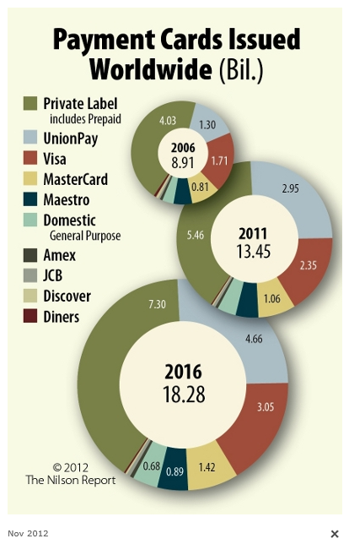
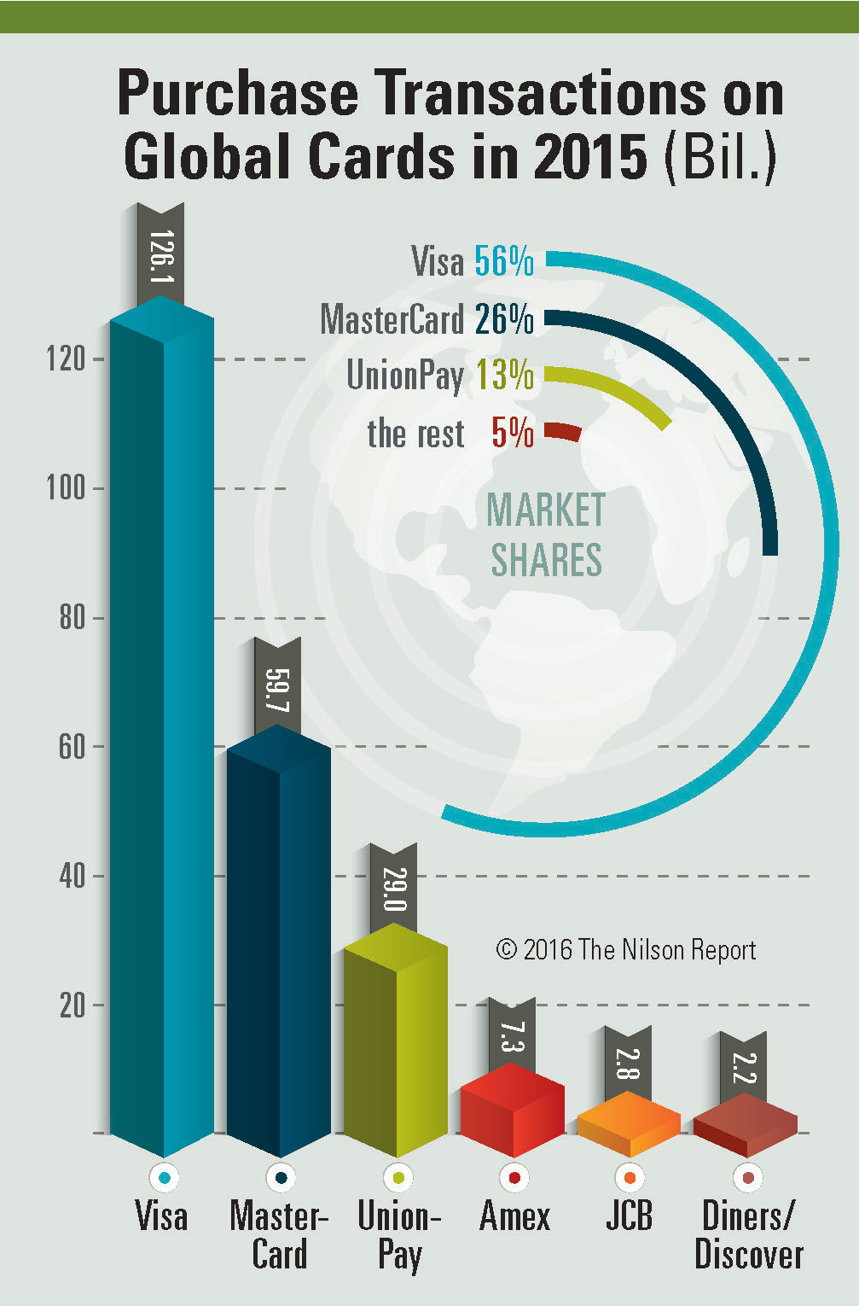
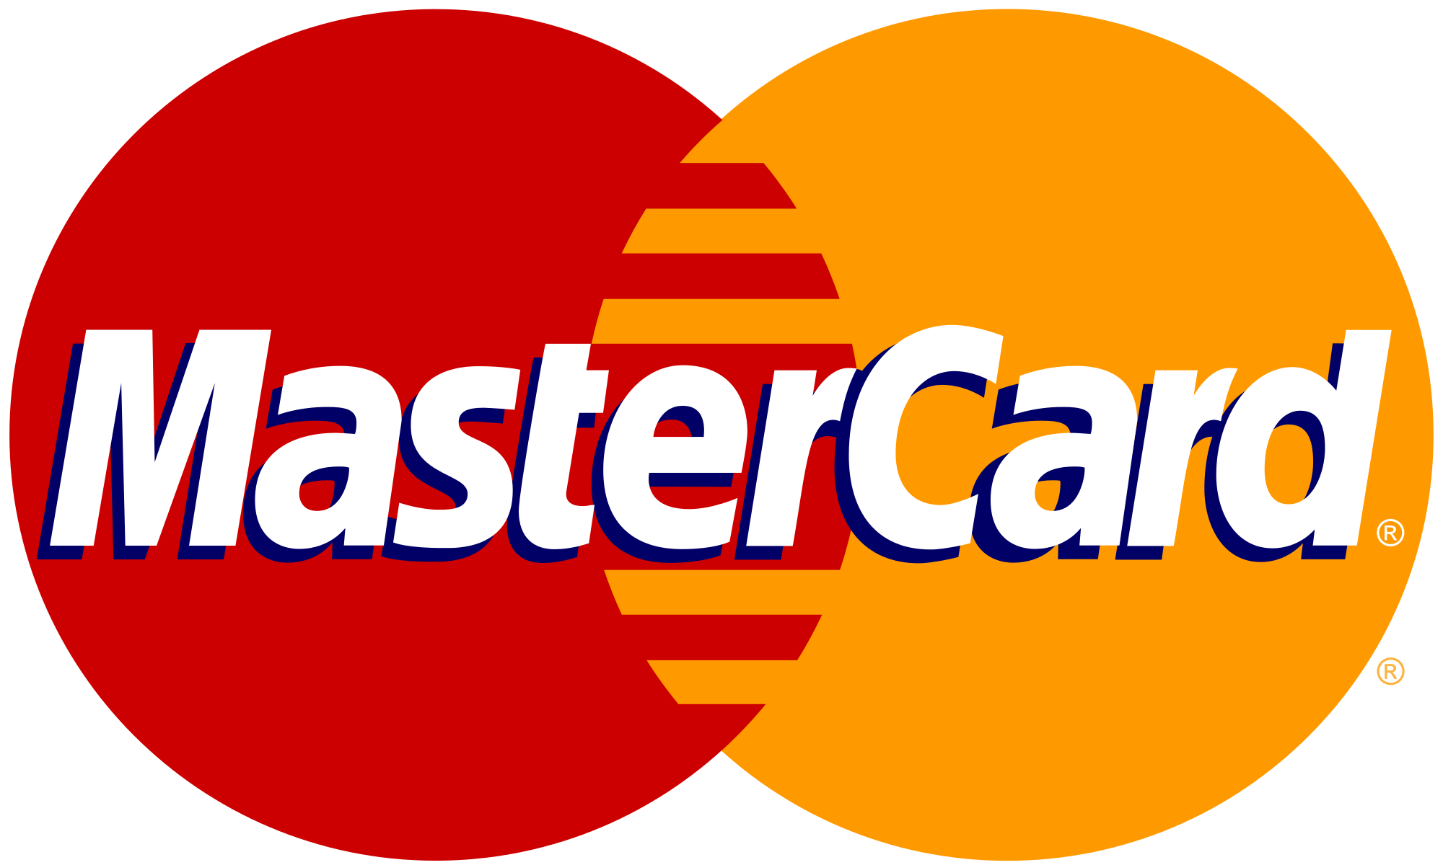
Quick Knowledge Test
Which payment brand has the most number of payment cards worldwide?
A. American Express
B. China Union Pay
C. Diners Club
D. JCB
E. MasterCard
F. Visa
Notes:
I know. You probably thought is was Visa. Here’s probably why.

Slide 7
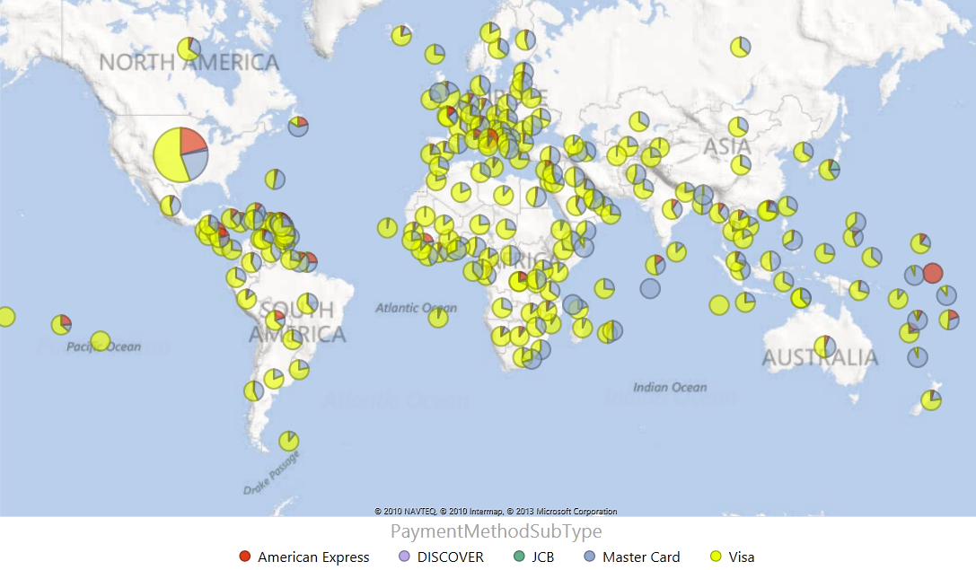
Credit/Debit Card Processing by CP

Slide 8
General Purpose vs. Local Payment Cards
General Purpose Cards
Global acceptance – cards can be used almost anywhere
Transactions can be performed in multiple currencies
Cards can be credit and debit cards depending on the account type being accessed
Typically Support Recurring Payments
Local Payment Cards
Cards can mainly be used in the country of issuance
Generally support only one currency
Most cards are debit cards (i.e. tied to a deposit account)

Slide 9
But Wait…There is More!
Other Cards
Debit Cards
Corporate and Purchasing Cards
Gift Cards (Pre-Paid and Stored Value)
Private Label Credit Cards, e.g. Sears Card
Notes:
Debit Cards
Linked to Bank Accounts
Process with a PIN or without a PIN
Chip and Pin - EMV
Corporate and Purchasing Cards
For Business purchases
Used for purchase of software licenses
Gift Cards (Pre-Paid and Stored Value)
Open-Loop can be used anywhere
Closed-Loop can only be used at limited locations
Private Label Credit Cards, e.g. Sears Card

Slide 10
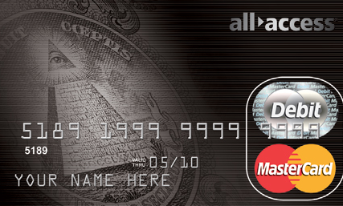
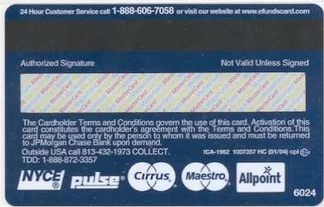
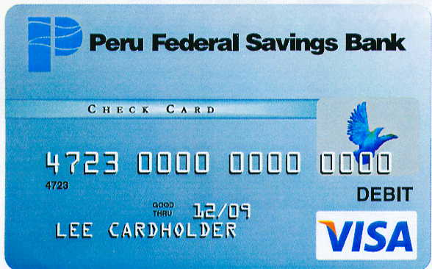
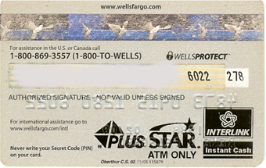
Credit Cards Have Multiple Personalities
…and this.
…More like this
No. Not like this.
International ATM use
Debit Indicator
International ATM use
Debit Indicator
CVV
International Point of Sale (POS) use
International Point of Sale (POS) use
Spoilers.
Sorry…
International acceptance brand
International acceptance brand
Domestic ATM use
Domestic ATM & POS use
Domestic ATM & Point of Sale (POS) use
Domestic ATM use

Slide 11
The Mechanics of Payment

Slide 12
Quick Knowledge Test Part 2
What percentage of the United States’ GDP is made up by purchases through electronic payments?
Hint: Including both credit and debit purchases
$28.7
Billion in 2015
Source: Visa.com, “Global Impact of Electronic Payments on Economic Growth”
Notes:
Averaged Weighted by GDP: 12%
Equates to more than $28 Billion a year

Slide 13
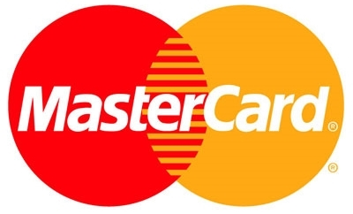
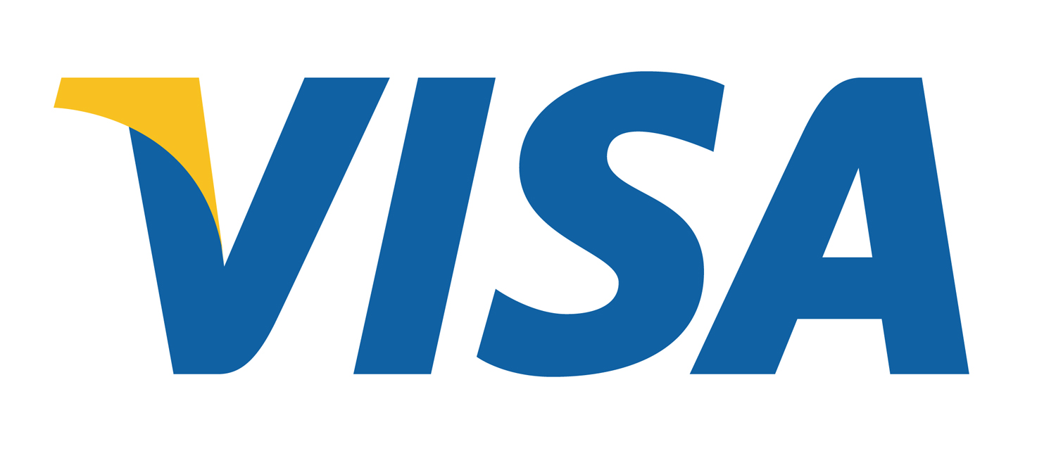
Let’s Look at an Average Payment Cycle
Step 2: Transaction Recorded
Step 1: Customer Makes a Purchase
Step 4: Clearing & Settlement
Step 5: Card Association Settlement Processing
Step 6: Authorization Process
Step 3: Authorization Request
CUSTOMER PURCHASE
ACQUIRING PROCESSOR
MERCHANT
NETWORK
CARD ISSUER
Customer makes a purchase with their electronic payment card.
Transaction recorded by merchant.
Transaction sent to merchant’s banks (AKA Acquiring Processor).
Acquiring Processor sends transaction through card network for validation.
Transaction confirmed by card network & posted to card issuer bank.
Merchant-Device-ID | CC Number | Amount | Curr | CVV | TRK2 | ExDt | Resp | Auth # | Time Stamp
061-3448069-3685309 | 5588320123456789 | 100.00 | USD | 425 | xxxxx | 01/08 | 000 | 123456 | 20080515102600
Merchant-Device-ID | CC Number | Amount | Currency | CVV | TRK2 | ExDt | Time Stamp
061-3448069-3685309 | 1234567812345678 | 100.00 | USD | 123 | xxxxx | 01/08 | 20080515102600
Card Issuer bank confirms the customer’s funds availability, and removes the appropriate amount (debit cards) or records transaction against available credit limit (credit cards).

Slide 14
Clearing & Settlement
ACQUIRING PROCESSOR
NETWORK
CARD ISSUER
Acquirer sends transaction files
Step 1
Step 2
Sort by BIN
Step 3
Calc. Fees
Step 4
Step 5
Calc. Net Position
Generate Outbound Files
Validate Data
Issuer receives files
Merchant-Device-ID | CC Number | Amount | Curr | CVV | ExDt | Resp | Auth # | CVN | AVS | Time Stamp
061-3448069-3685309 | 5588320123456789 | 100.00 | USD | 425 | 01/08 | 000 | 123456 | Y | P | 20080515102600
Merchant-Device-ID | CC Number | Amount | Curr | CVV | ExDt | Resp | Auth # | CVN | AVS | Time Stamp
061-3448069-3685309 | 5588320123456789 | 100.00 | USD | 425 | 01/08 | 000 | 123456 | Y | P | 20080515102600
Merchant-Device-ID | CC Number | Amount | Curr | CVV | ExDt | Resp | Auth # | CVN | AVS | Time Stamp
061-3448069-3685309 | 5588320123456789 | 100.00 | USD | 425 | 01/08 | 000 | 123456 | Y | P | 20080515102600
Merchant-Device-ID | CC Number | Amount | Curr | CVV | ExDt | Resp | Auth # | CVN | AVS | Time Stamp
061-3448069-3685309 | 5588320123456789 | 100.00 | USD | 425 | 01/08 | 000 | 123456 | Y | P | 20080515102600

Slide 15
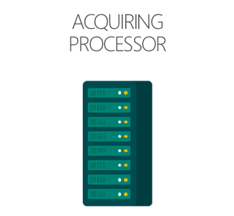
How Microsoft Handles Settlement Processing
Day 1
Day
Processors deposit funds net of fees to Microsoft bank accounts
Processors send ‘EPA File’ with settlement data
Sales
Less fees and chargebacks
Plus adjustments
FinOps reconciles deposits received to the settlement data

Slide 16
Third-Party Payment Process
Similar, but with a slight change to the workflow
MERCHANT ACQUIRER
NETWORK
CARD ISSUER
ACQUIRING PROCESSOR
CUSTOMER
MERCHANT

Slide 17
Where the Money Is

Slide 18
Quick Knowledge Test Part 3
Which member of the payment process receives the largest share of payment processing fees?
Merchant acquirer
Card Issuer
Visa/MasterCard Association
Acquirer
Associations

Slide 19
Fees Structure, Or Who Gets Paid
CUSTOMER PURCHASE
ACQUIRING PROCESSOR
MERCHANT
NETWORK
CARD ISSUER
Customer makes a purchase of $100
Fees Include
Transaction Processing Fees
Other Fees
Customer pays their bill of $100 to their credit card bank.
Merchant sends $100 charge to acquiring processor
Acquiring Processor sends $100 charge to card networks
Fees Include
Assessment
APF/NABU
Fees Include
Interchange Fee
Merchant receives $97.72
Acquiring Processor receives $97.82
Acquiring Processor pays Merchant $97.72
Card networks sends $100 charge to card issuing bank
Bank bills the customer for $100
Card Network receives $97.95
Card Network Pays Acquiring Processor $97.82
Bank receives $100 payment
Bank pays Card networks $97.95
Total Merchant Cost: $2.28
-$.10
-$.13
-$2.05

Slide 20
Chargebacks

Slide 21
So, What Happens with Disputes
Sometimes customers dispute a charge …
CUSTOMER PURCHASE
ACQUIRING PROCESSOR
MERCHANT
NETWORK
CARD ISSUER
Customer disputes a charge with their card issuing bank.
Acquiring processor passes chargeback to merchant.
Merchants receives chargeback and either accepts or disputes charge.
Acquiring processor provides chargeback & supporting documentation to Credit Card networks
Merchants represents chargeback and provides supporting documentation to acquiring processor
Network passes chargeback to acquiring processor.
Credit acquirer/debit issuer
Send representation to issuer
Need Text
Bank creates a chargeback and passes it to the network.

Slide 22
Security and Trust

Slide 23
Security Breaches Occur…

Slide 24
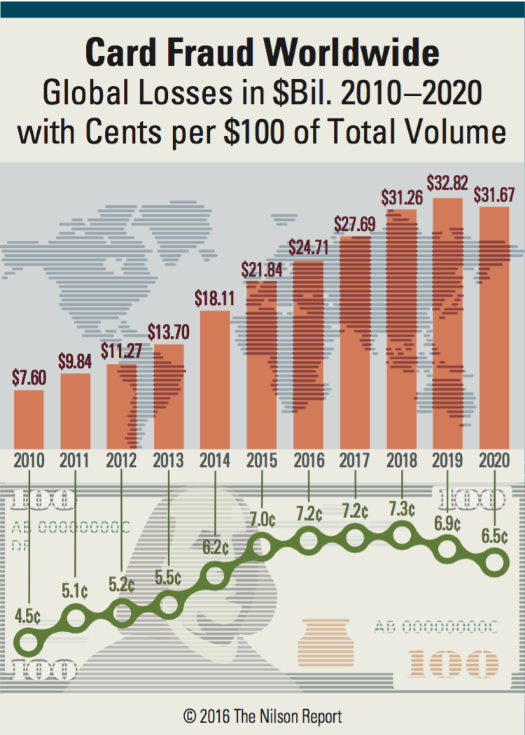
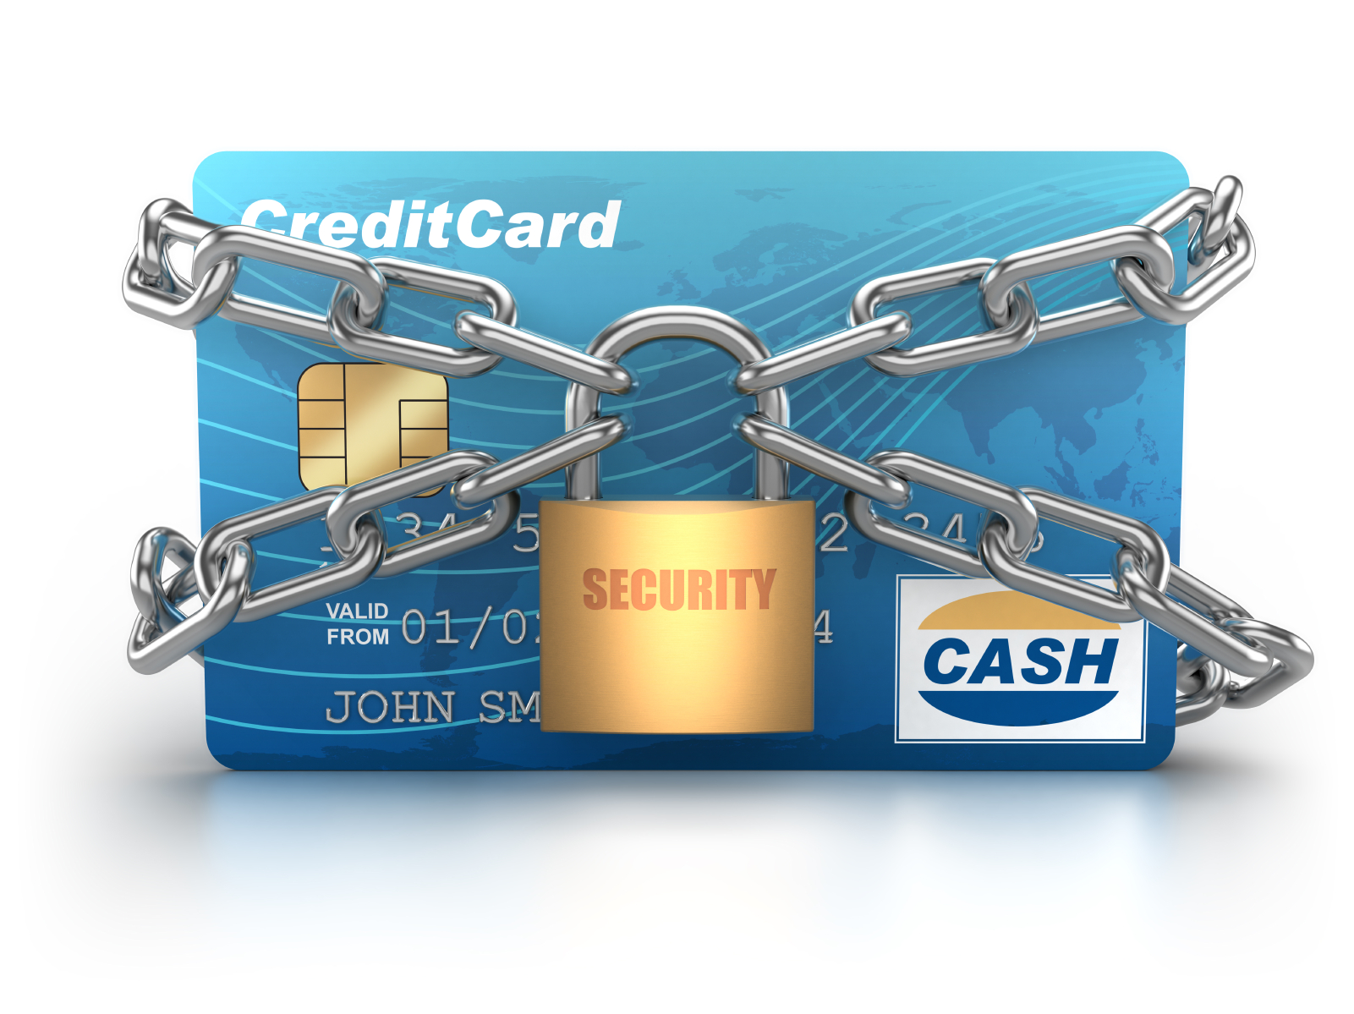
Consumer Trust Require Security
Significant breaches have put consumer confidence at risk
Perpetrators are professional criminals
Phishing and hacking dominate in breaches
WiFi and cloud-based storage have increased data breaches

Slide 25
Breach Responses
PCI DSS
Payment Card Industry Data Security Council
Publishes a Data Security Standard (DSS) applies to any entity that handles card data
Card Associations Levies Fines for Breaches
EMV Chip and PIN
Cards are embedded with security chips
Require a PIN for completing the transaction
Enhances security significantly due to two factor authentication
Prevalent in Europe, slow to take off in US, but it’s coming…
Point to Point Encryption
Card Data is encrypted upon swipe on POS device
Card Data is never decrypted until it reached a payment processor
P2P Encrypted data is out of scope for PCI Audits

Slide 26
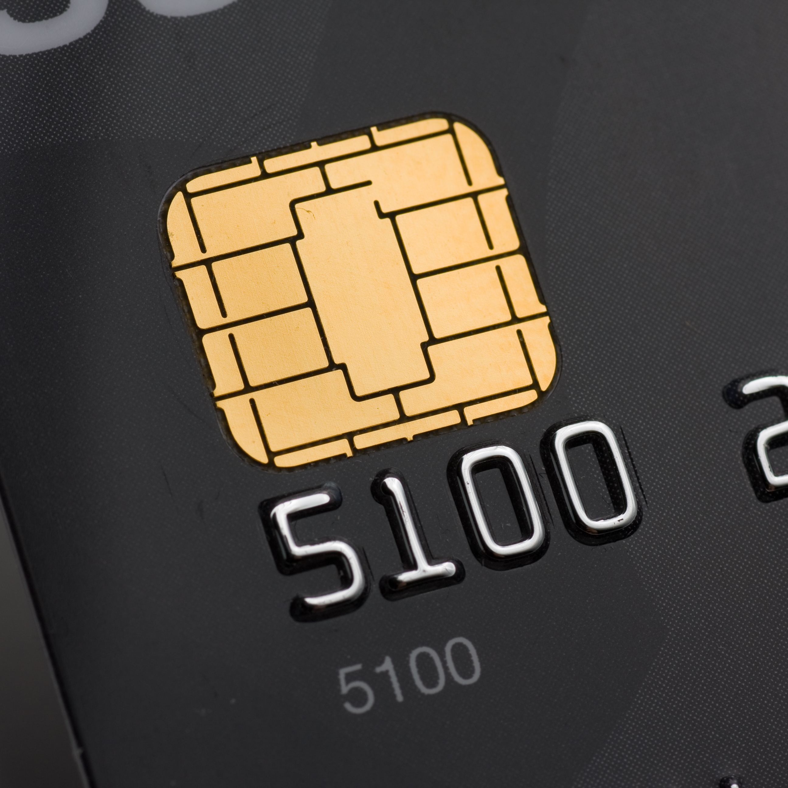
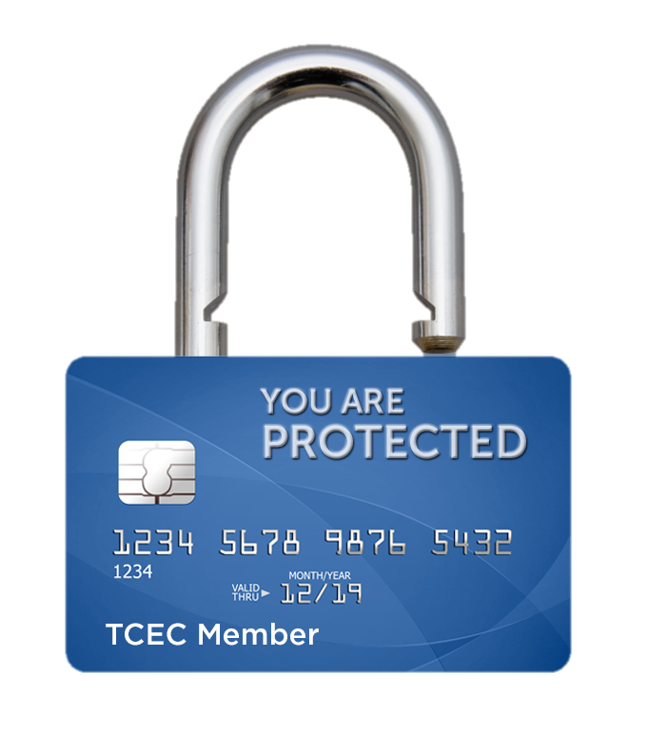
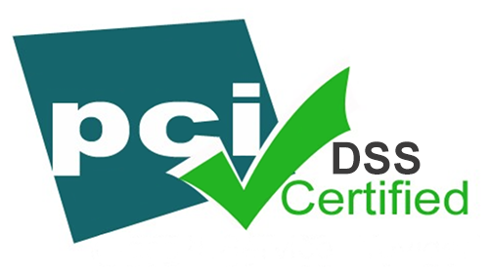
Card Industry Responses
PCI DSS
EVM Chip
Payment Card Industry Data Security Council
Cards are embedded with security chips
Point- To-Point
Publishes a Data Security Standard (DSS) applies to any entity that handles card data
Card associations levy fines for breaches
Require a PIN for completing the transaction
Enhances security significantly due to two factor authentication
Prevalent in Europe, slow to take off in US, but it is starting to take hold
Card data is never decrypted until it reaches a payment processor
P2P encrypted data is out of scope for PCI Audits
Card data is encrypted upon swipe on Point-of-Sale device

Slide 27
Disruptors and Innovators

Slide 28
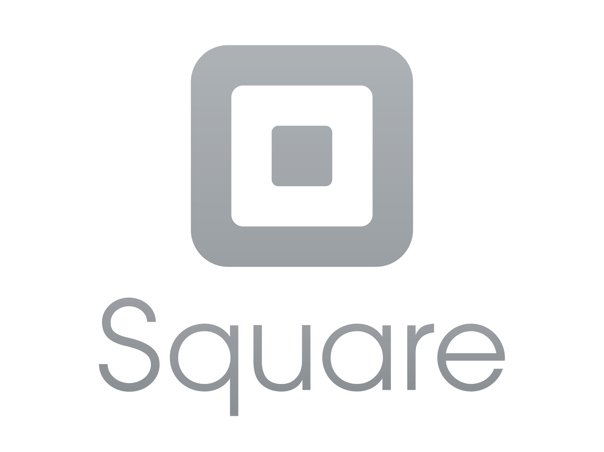
Disrupters
Visa & Mastercard
Very profitable global networks
PayPal & Amazon Disintermediating Visa and MasterCard
Starbucks Created proprietary closed loop reloadable card, cash replacement
Uber Promoted & marekete digitization of physical experiences
Square Led mobile payment processing to micro-merchants

Slide 29
Volume Accounts
Square Created a New Market
Traditionally, “Mom & Pop” merchants had the highest number of accounts…
Square’s Gross Payment Volume (GPV) grew 47% YoY to $10.2 billion in 2015
…While Enterprise accounts held the highest number of sales volume

Slide 30
Square Created a New Market
Square’s Gross Payment Volume (GPV) grew 47% YoY to $10.2 billion in 2015
Source: Squareup.com, Investor 2015 Year End Results, March, 9, 2016
Notes:
Formula:
Simple Card Reader that plugs into Smart Phone
Ubiquity of Smart Phones
Approve all merchants but restrict payments to merchants
Merchants can apply online and are typically approved
Merchants are vetted before they are allowed to process high volumes of payments.
This limits credit losses, which helps drive profits
Simple, Convenient Consumer User Experience
Sign for purchase on mobile screen
Tap into Micro Merchants – New Market, Limited Competition
Extend to Tablet Devices

Slide 31
End Game

Slide 32
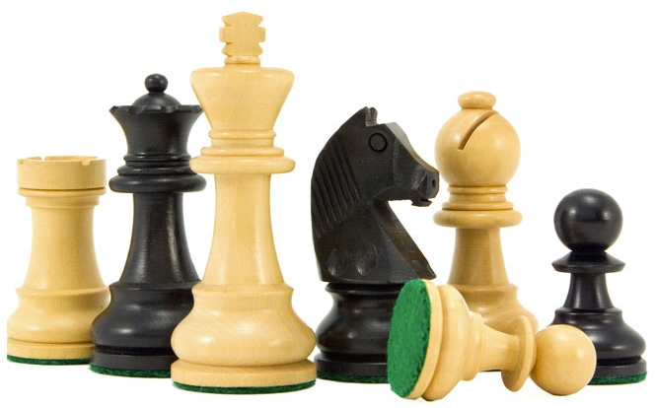
Takeaways
Cards are a dominant payment method worldwide
Usage continues to grow, especially in ecommerce
Card permutations play significant role in world’s economic engine
Visa/MasterCard Four Party model is a wel
Visa & MasterCard’s 4 party model
Yes, it is no doubt a well-oiled machine. And yes, it is tough to disrupt, but…
There are plenty of challengers in the form of both startups as well as establishment players from different industries showing up and giving the 4 party model a run for its money
The opportunity to innovate is here

Slide 33
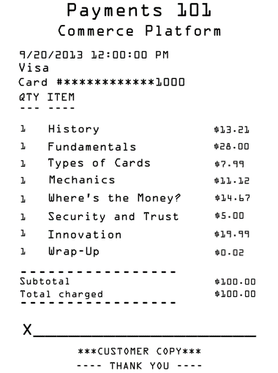
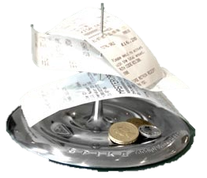
The Takeaway: Making Sure You Got Your Money’s Worth
Cards & Their Place in the Economy
Cards are a dominant payment method, and usage continues to increase in existing and new markets – especially with the rise of E-Commerce
Cards – in all their permutations – play a significant role in the world’s economic engine
Visa & MasterCard’s 4 party model
Yes, it is no doubt a well-oiled machine. And yes, it is tough to disrupt, but…
There are plenty of challengers in the form of both startups as well as establishment players from different industries showing up and giving the 4 party model a run for its money
The opportunity to innovate is here

Slide 34
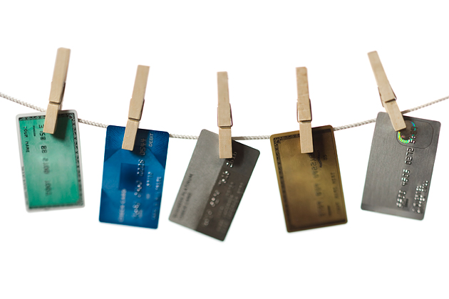
Congratulations on completing Payments 101!
Interested in continuing the discussion?
Payments 201: Alternative Payment Methods
Payments 301: Developer/Seller Payouts
Payments 401: Currency Based Stored Value
Payments 501: Emerging Payment Trends

Slide 35
© 2012 Microsoft Corporation. All rights reserved. Microsoft, Windows, Windows Vista and other product names are or may be registered trademarks and/or trademarks in the U.S. and/or other countries.
The information herein is for informational purposes only and represents the current view of Microsoft Corporation as of the date of this presentation. Because Microsoft must respond to changing market conditions, it should not be interpreted to be a commitment on the part of Microsoft, and Microsoft cannot guarantee the accuracy of any information provided after the date of this presentation. MICROSOFT MAKES NO WARRANTIES, EXPRESS, IMPLIED OR STATUTORY, AS TO THE INFORMATION IN THIS PRESENTATION.

Slide 37
Types of Card Payment Networks
A Two Party System (a.k.a. Private Label Credit Card)
Merchant do not pay transaction fees
They have access to cardholders’ demographic data
Merchants own the debt and risk of non-payment
Consumer
Presents card while shopping
Pays bill when presented
Applies for credit from retailer
Retailer
Approves credit & issues card
Authorizes purchases
Bills customer & process payment

Slide 38
Types of Card Payment Networks
A Three Party System (e.g. American Express)
Third party issues card and carries debt and risk of non-payment
Merchant pays transaction fees
Consumer
Pays bill when presented
Applies for credit from issuer
Issuer
Approves credit & issues card
Bills customer & process payment
Retailer
Request purchase authorization
Issuer
Approves purchases
Consumer
Presents card when shopping
Retailer
Sells merchandise

Slide 39
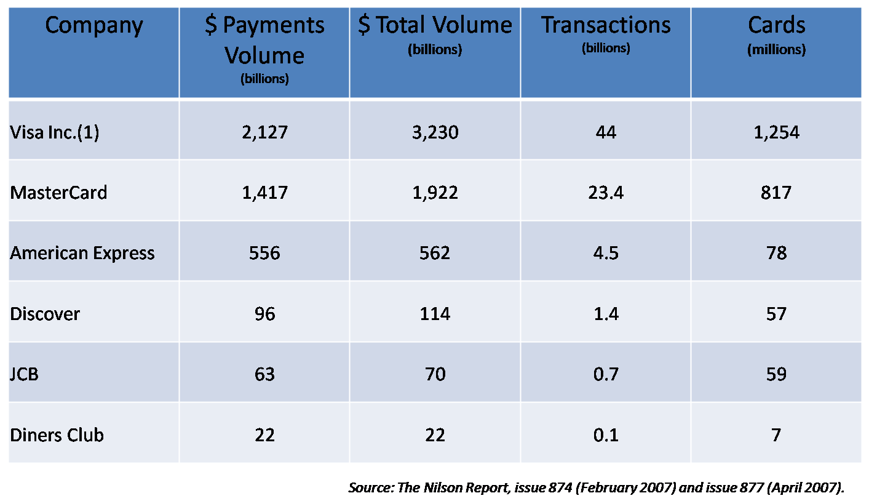

Slide 40
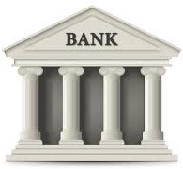
Arbitration
Arbitration Phases
If after a second chargeback there is still a dispute, the chargeback is taken to arbitration where a VI or MC panel adjudicates who is liable for the transaction.
Acquirer
Issuer
Merchant

Slide 41
What is Interchange?
Transfer price between the Acquirer and Issuer
Originally intended to reimburse issuers for specific costs
Explicit revenue to Card Issuer, cost to Merchant Acquirer
Not a revenue source for Brands (i.e. Visa or MasterCard) or Acquirers
Approximate Breakdown of $1 Merchant Fees (USA)

Slide 42
PV
Merchant Proceeds
Merchant can receive a bundled “discount” on the value of the transaction amount (e.g. 2.50%) or it can pay all VI/MC and issuer fees as a “pass- through” and pay separate acquirer fees (e.g. 10¢ per transaction as in this example) for a net total fee of $2.28 on a $100 transaction or
an effective cost of payments of 2.28%

